Slide 1
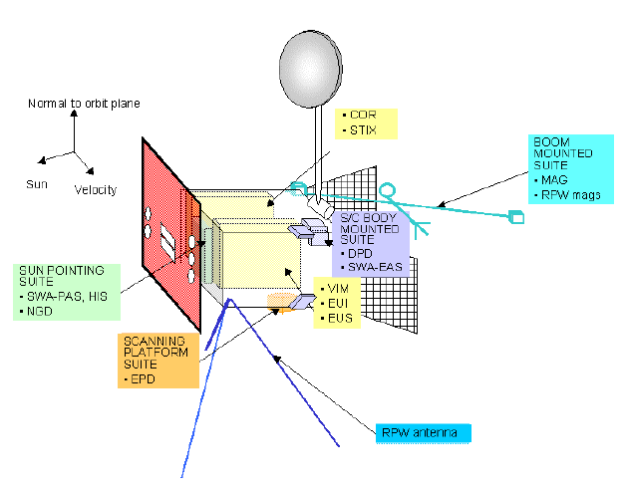
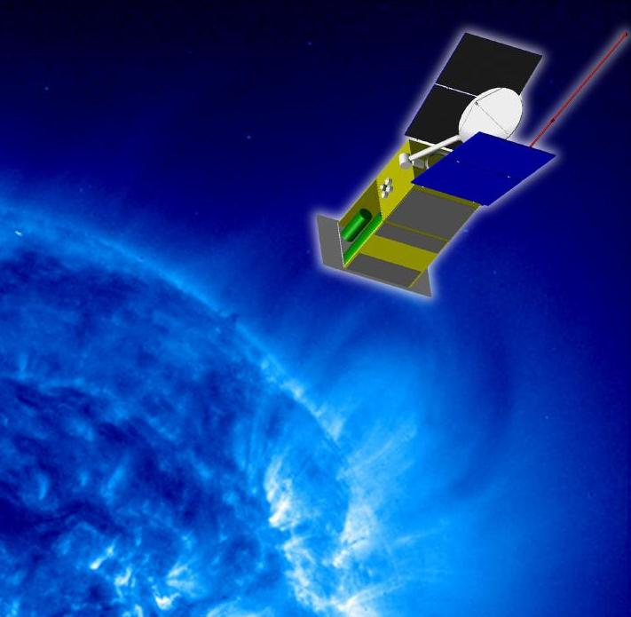
Solar Orbiter wire-grid modelling
G. Fischer, W. Macher, T. Vejda, M.Y. Boudjada
Meeting at Graz, Nov. 2005

Slide 2
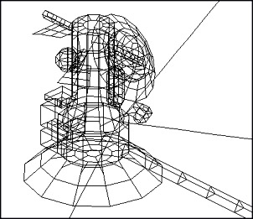
What is wire-grid modelling?
Construction of model of a body consisting of nodes and conducting wires, where a voltage is applied at a certain node (feed point)
Electromagnetic codes are applied to calculate the currents at the wires
ASAP (Antenna Scatterers Analysis Program, freeware) and CONCEPT (Univ. of Hamburg)
At IWF wire-grid modelling was/is applied for Cassini/RPWS, Interball/POLRAD, Mars Express/ MARSIS, and Stereo/WAVES

Slide 3
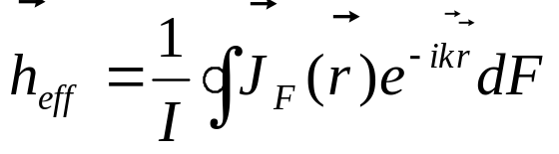
Input and output parameters
Geometry of the body (described by 2 matrices: node positions and segment connections via node numbers)
Feed point: Magnitude and phase of voltage
Wires: conductivity and radius
Wave frequency (reciprocity principle)
Loads (resistors, capacitances in the structure)
Calculation of current distribution as basis and then calculation of
Effective length vectors
Antenna impedances
Gains, power patterns in 2D and 3D
Near field and far field
All this as a function of frequency!

Slide 4
What information do we need?
Geometry and structure of spacecraft: dimensions of all parts (detailed plan)! Any moveable parts?
Information about electric properties of the surface: conductivity of various parts. Are there any resistive loads in the structure (e.g. between solar panels and s/c body)?
Information about antennas and their mounting zones (detailed geometry): construction and radius of antennas, capacitances of antenna mounting, coax cable, and preamplifier (receiver input). Is there an impedance matching network?
Receiver information: modes, frequency ranges, antennas driven as monopoles or dipoles etc.

Slide 5
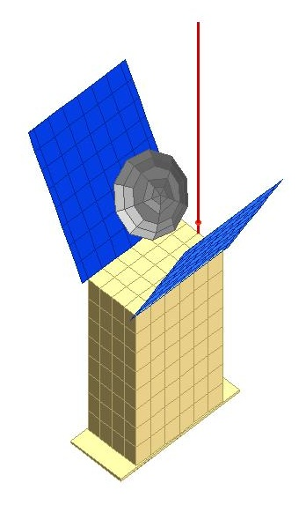
Solar Orbiter wire grid
Without s/c body the effective axis of a dipole is along the physical antenna and half of its length
Influence of s/c body leads to a bending of the effective length vector (parts close to antenna push the effective axis away)
Dipole on s/c is less influenced than monopole (i.e. a dipole where second dipole arm is the s/c)
Effective length is reduced by base capacitance C_{B} by a factor of C_{A}/(C_{A}+C_{B}) with C_{A} as the antenna capacitance (e.g. 100 pF for RPWS antennas)

Slide 6
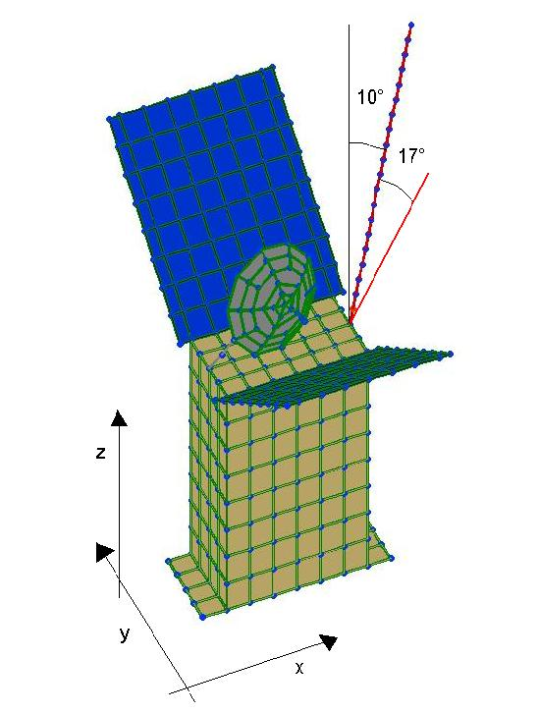
Result for first calculation (500 kHz)
Physical antenna: length of 2 m, azimuth 0°, colatitude 10°
Effective antenna: length of 1.1 m, azimuth 0° (symmetry!), but colatitude of 27°
We can start such calculations when configuration is fixed and we have all necessary information!

